Slide 1
DUKE ENERGY CORPORATION
(DUK)
Sector: Utilities
Industry: Electric Utilities
Recommendation: BUY
Presented By:
Noam Avraham, Krishna Patel, Stephanie Liu

Slide 2
AGENDA
Overview of DUKE Energy Corporation
Key Financial Statistics
SWOT Analysis
Sector & Industry Overview
Competitor Analysis
Catalysts
Risks
Invesment Thesis
Portfolio Considerations
Valuation

Slide 3
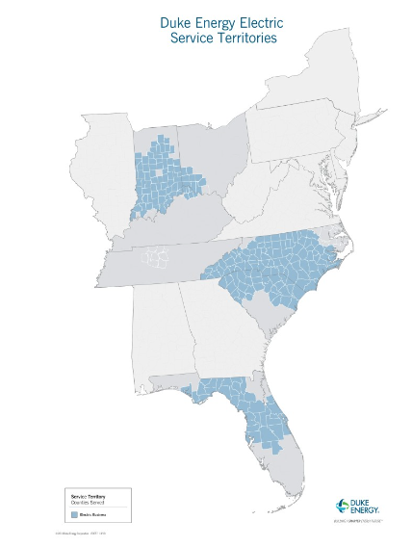
Company Overview
Duke Energy Corporation, a Fortune 150 company based in Charlotte, North Carolina, is one of the largest energy holding companies in the U.S., with an $80 billion market cap as of December 2022. It provides electricity to approximately 8.2 million customers and natural gas to 1.6 million customers across six states. Its electric utilities own a substantial 50,000 megawatts of energy capacity, spanning a service area of 92,000 square miles.
Business Segment
Duke Energy's segment structure includes two reportable business segments: Electric Utilities and Infrastructure (EU&I) and Gas Utilities and Infrastructure (GU&I). The remainder of Duke Energy’s operations is presented as Other. Commercial Renewables is reported as discontinued operations and is no longer a reportable segment beginning in the fourth quarter of 2022.

Slide 4
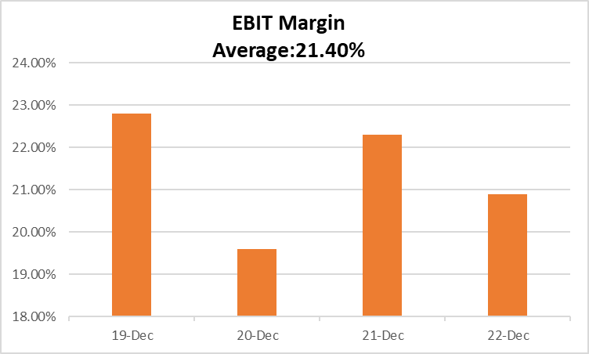
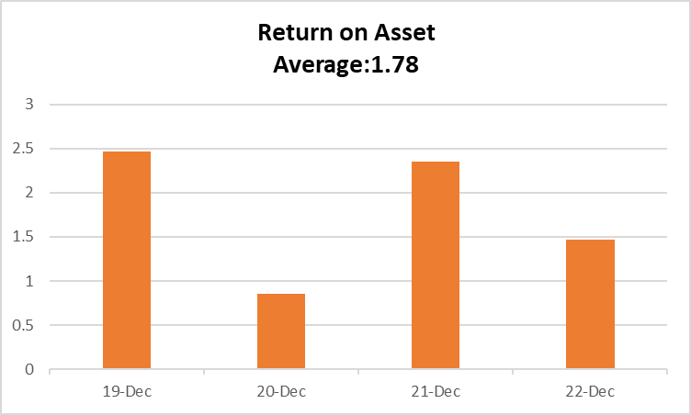
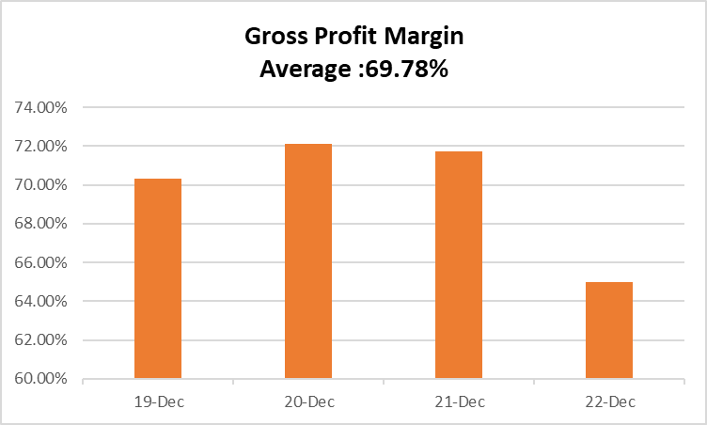
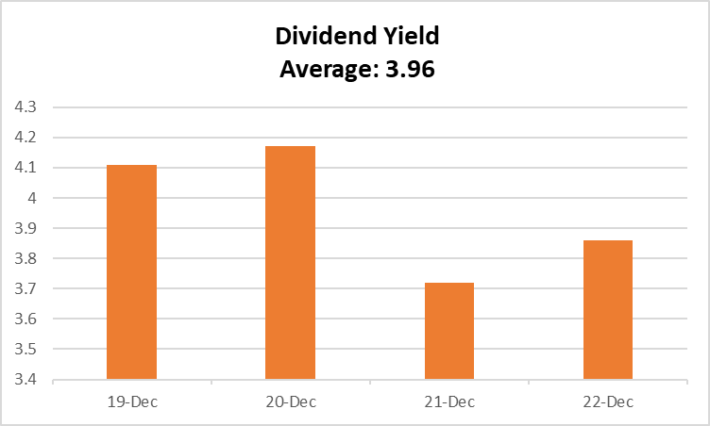
Key Statistics

Slide 5
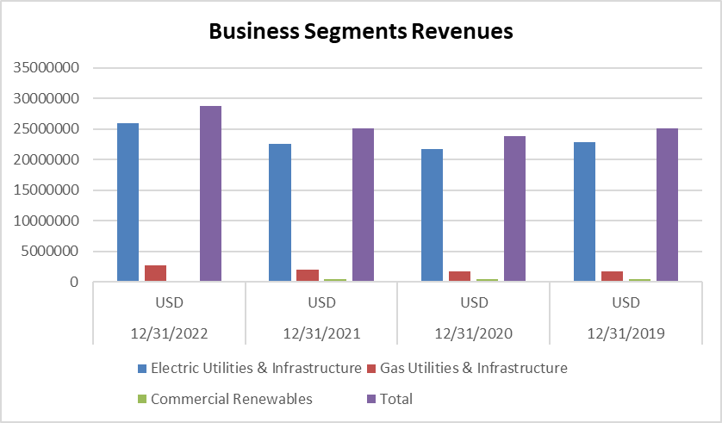
Business Segments Revenues

Slide 6

SWOT ANALYSIS
SWOT ANALYSIS
STRENGHTHS
Expansive consumer base – spans multiple diverse industries
Strong vertical integration and diversified generation portfolio. Revenue of US$28.77Bn million, an increase of 15.4% from 2021
Product/Service Diversity: Extensive service portfolio
WEAKNESSES
Operations are heavily concentrated in EU&I.
OPPORTUNITIES
US government incentives for renewable energy production
Positive outlook for electricity sales to retail customers in the US
Positive outlook for US renewable energy market
THREATS
Compliance with environmental laws and regulations
Intense competition
Fluctuations in commodity prices
Source(s): Marketline

Slide 7
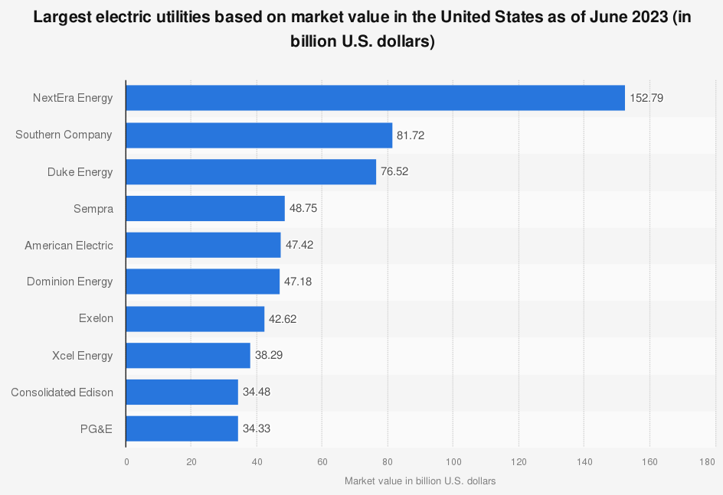
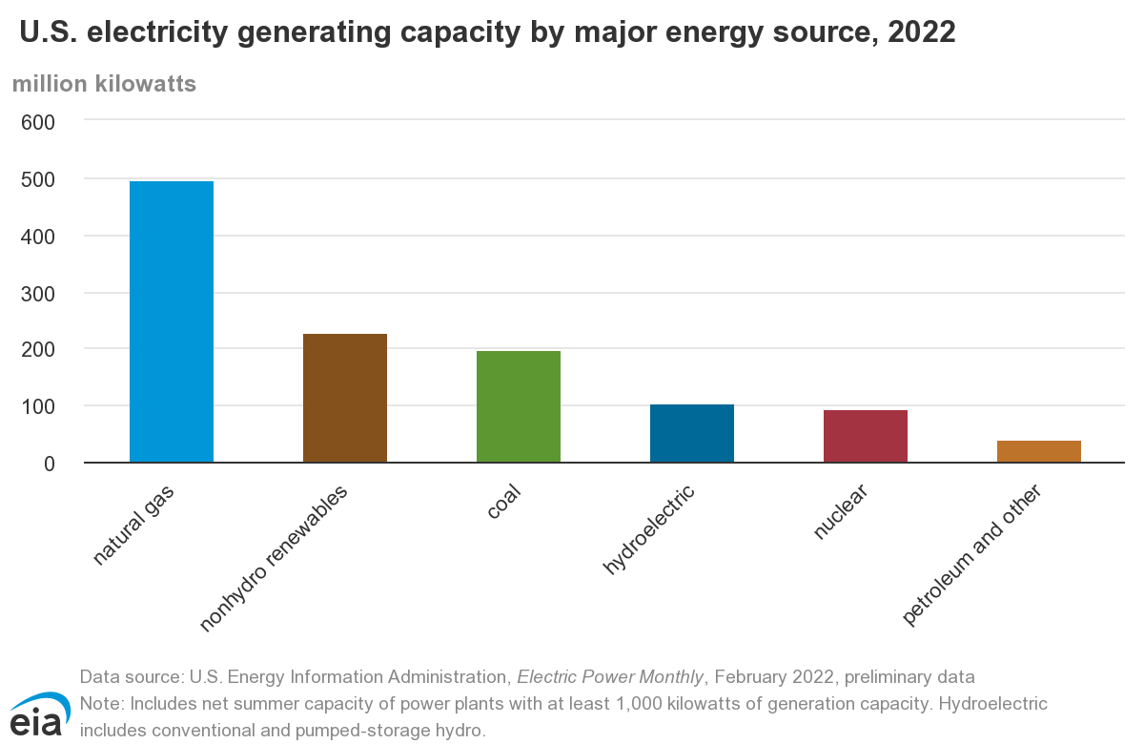
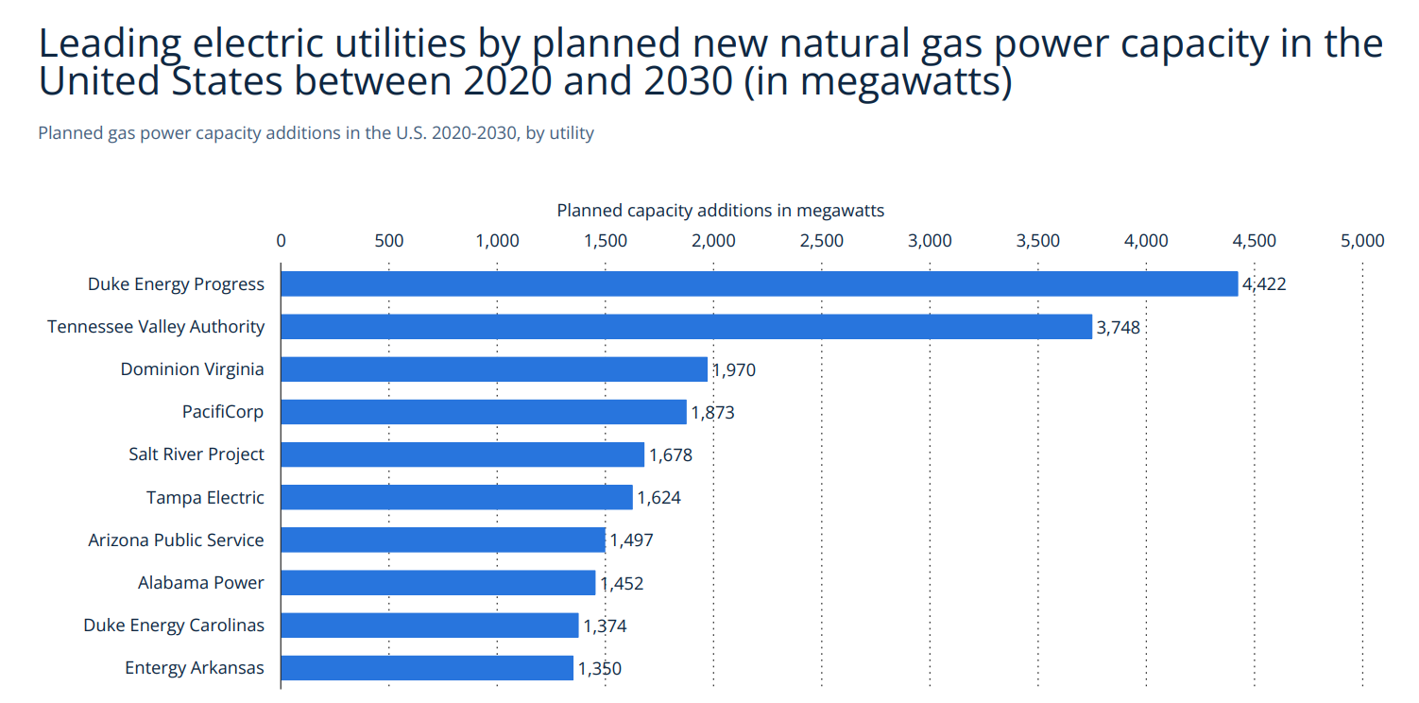
SECTOR & INDUSTRY OVERVIEW
US electricity sales continued to rise in 2022 as the market continues to recover from the pandemic.
Sales increased 3.6% in the first 8 months compared to the prior year
Sales growth suppressed by significant increase in costs (15.8% increase in Revenue)
Ex. Natural gas prices more than doubled due to global shortages exacerbated by the conflict with Russia
In response to extreme climate, industry and policymakers worked to bolster reserves, deploy energy storage and microgrids, strengthen infrastructure, etc.
Providing secure, reliable, affordable, and clean electricity is a rising problem as inflation, high fuel costs, and supply chain snags will keep electricity prices elevated
Renewable energy experienced industry wide growth driven by soaring demand and attractive long-term incentives
Renewable energy industry did incur a suppression in growth due to rising costs and delays, driven by supply chain disruption, trade policy uncertainty, inflation, rising interest rates, and interconnection delays.
Many challenges in 2022 will carry over into 2023, but growth will be driven by demand and clean energy incentives in the Inflation Reduction Act (IRA)
Source(s): Statista, IBIS, Statista, U.S. Energy Information Administration

Slide 8
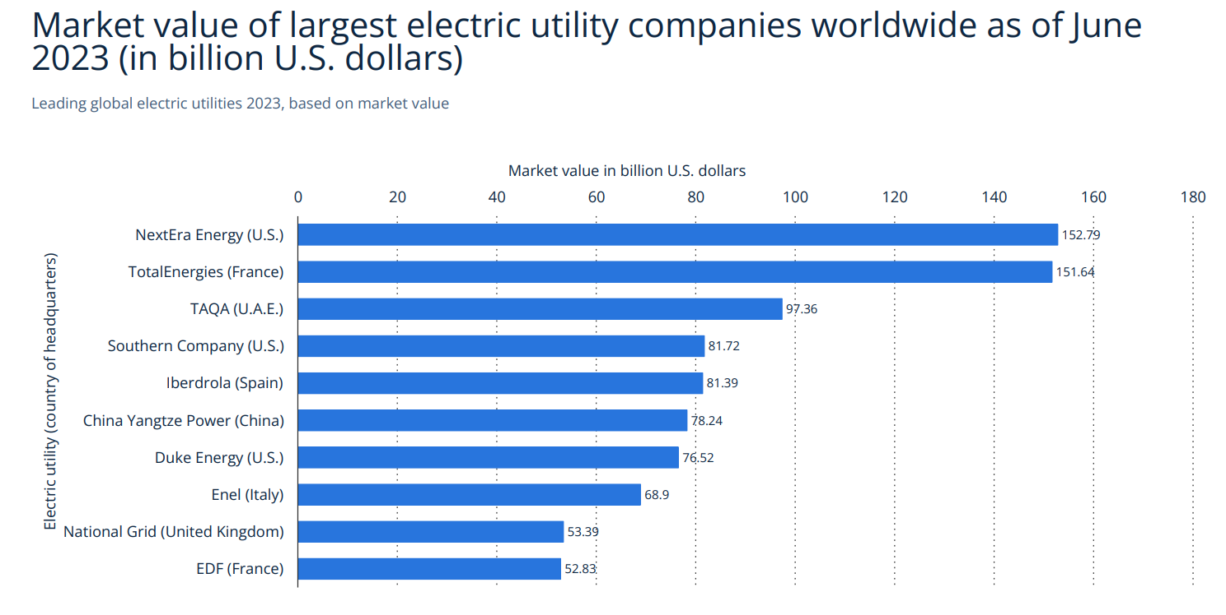
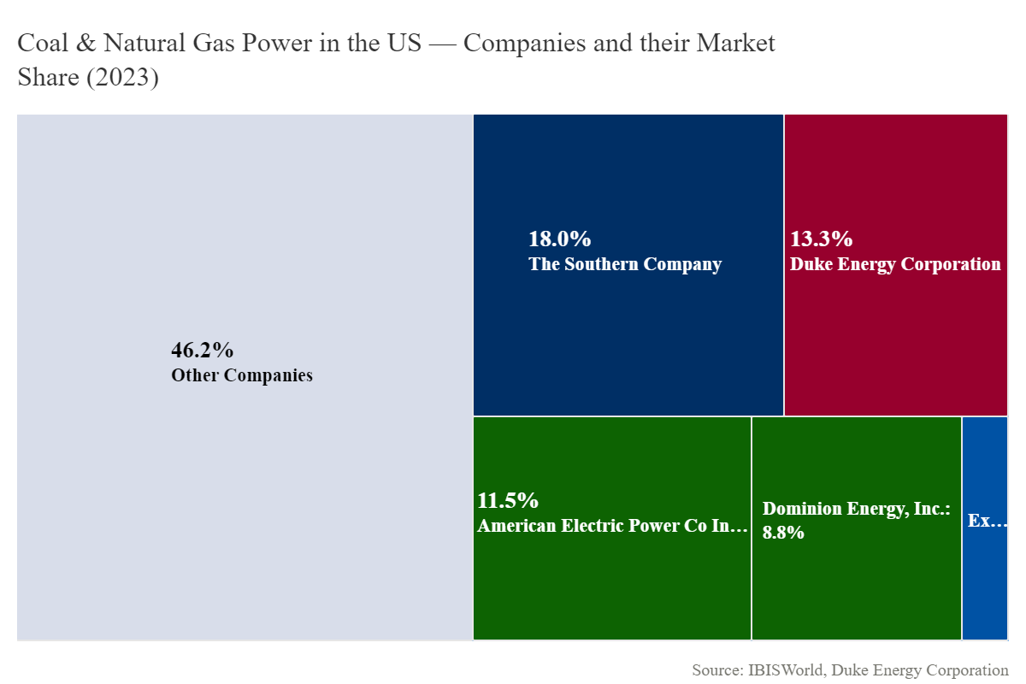
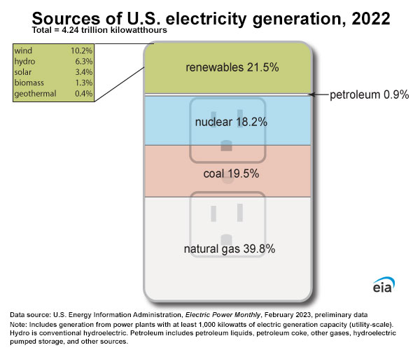
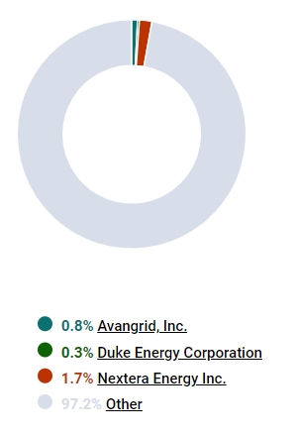
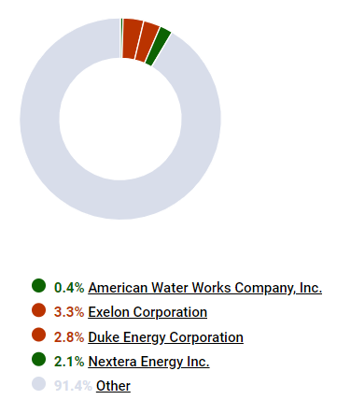
SECTOR & INDUSTRY OVERVIEW
Coal & Natural Gas Power in the US: Companies & Market Share (2023)
Wind Power Breakdown by Market Share
Utilities Sector Breakdown by Market Share
Source(s): Statista, IBIS, Statista, U.S. Energy Information Administration

Slide 9
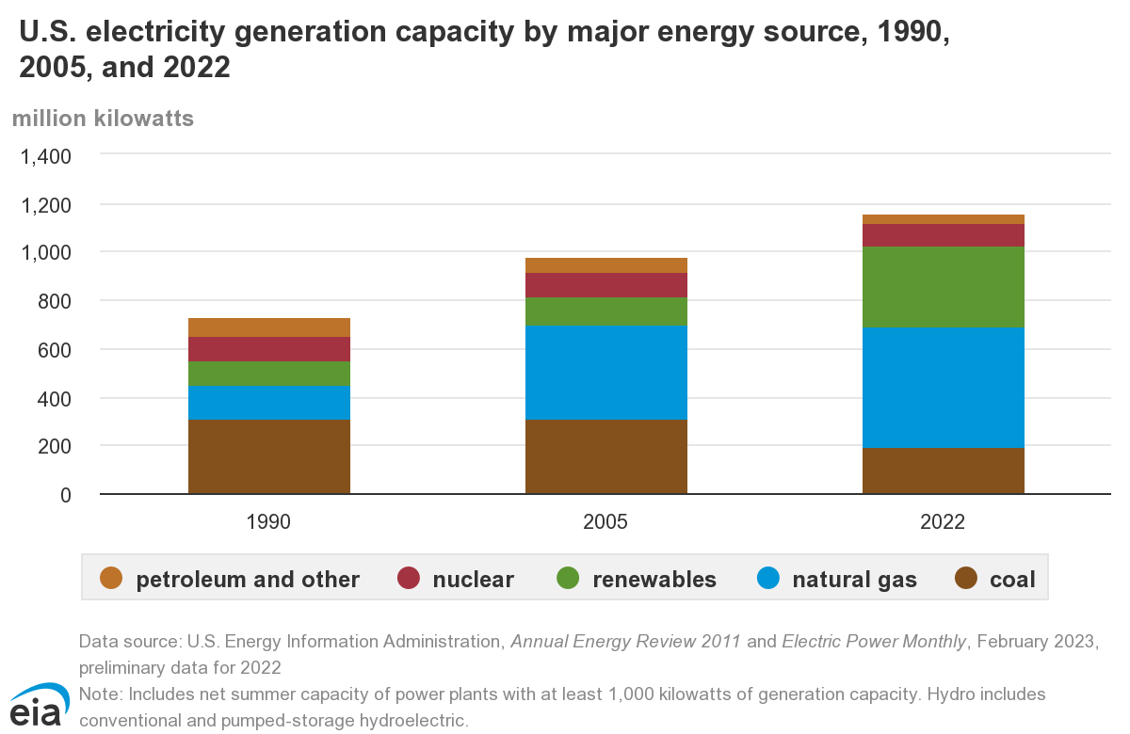
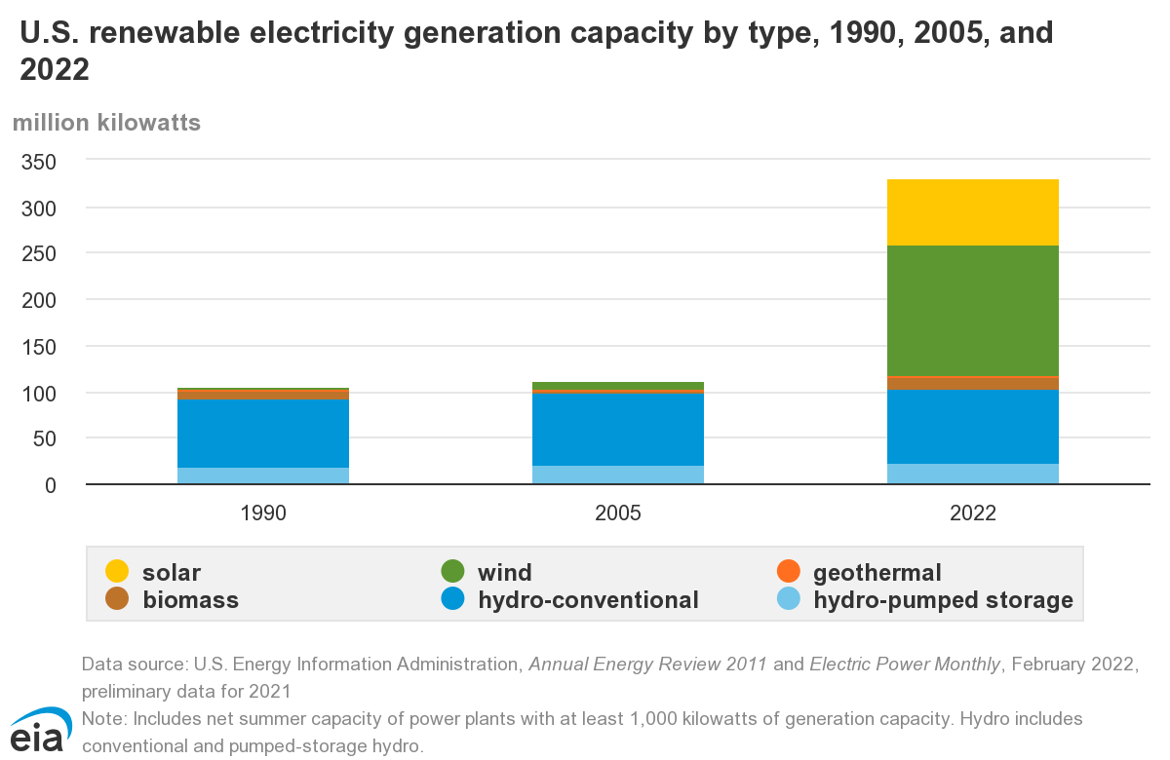
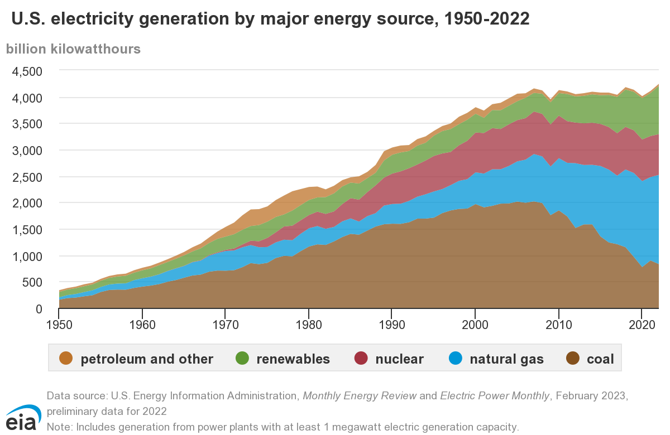
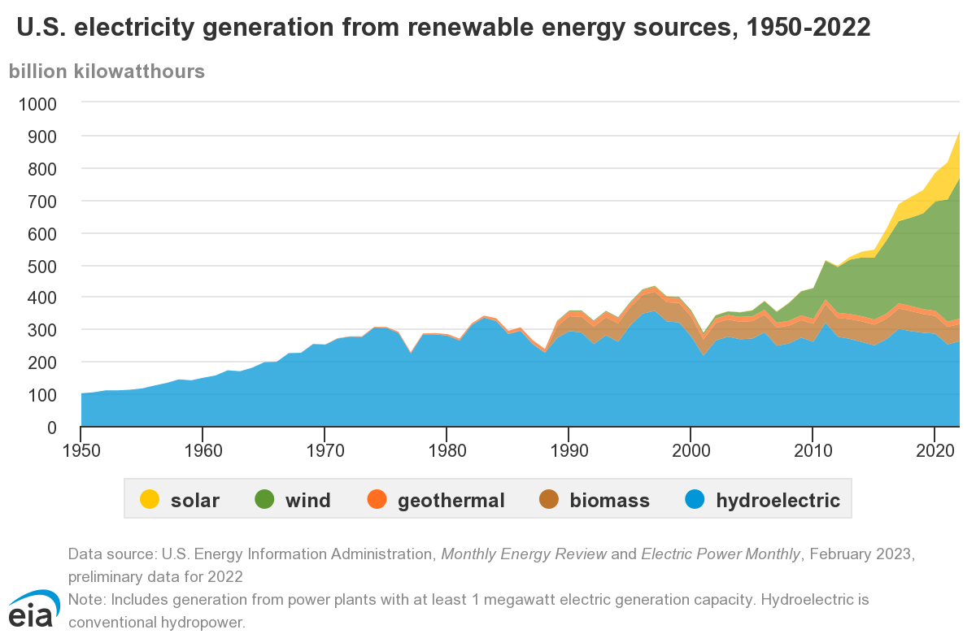
SECTOR & INDUSTRY OVERVIEW

Slide 10
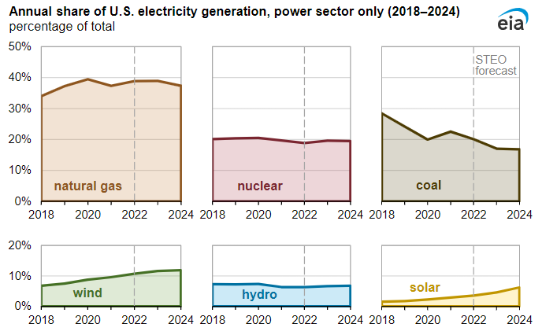
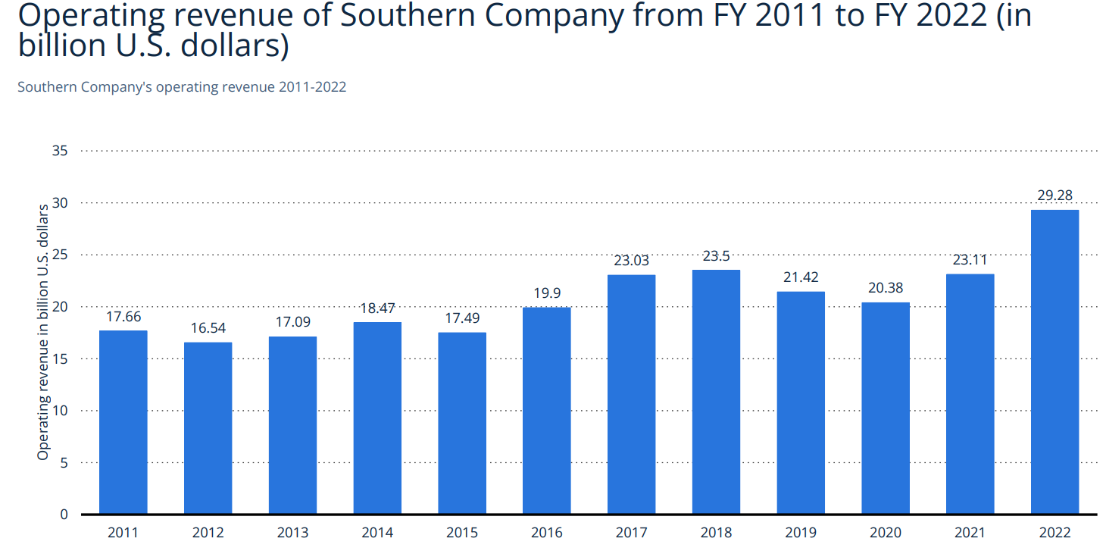
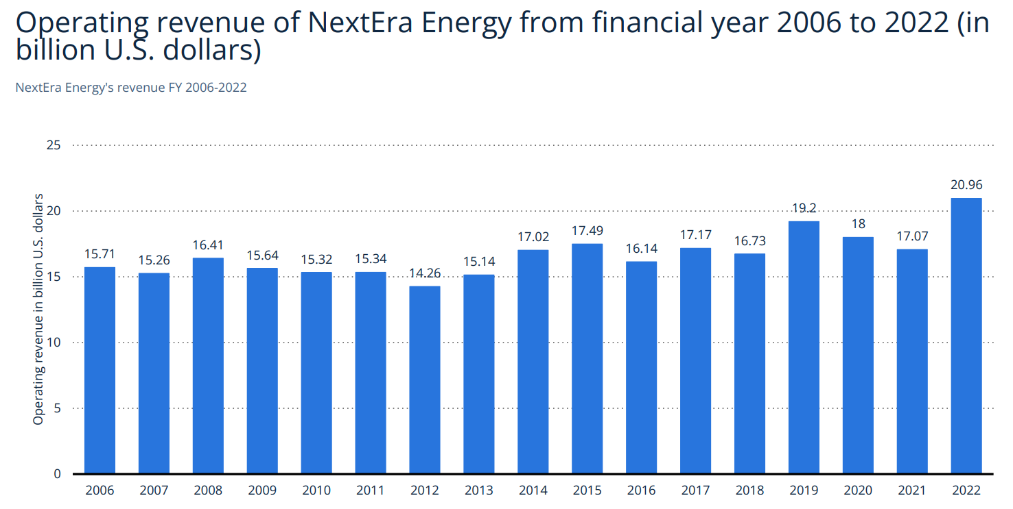
COMPETITOR ANALYSIS
Industry: Electric Utilities
1. The Southern Company (SO) (Market Cap: $78.89B)
Revenue: $29.27B (23.68% increase from 2021)
Business Segments: Gas Distribution Operations, Gas Pipeline Investments, Gas Marketing Services
2. NextEra Energy (NEE) (Market Cap: $147.27B)
Revenue: $20.97B (22.77% increase from 2021)
Business Segments: Operates through subsidiaries – Generates, transmits, distributes, sells electric power in North America (retail, wholesale)
3. American Electric Power Company (AEP) (Market Cap: $44.006B)
Revenue: $19.64B (16.96% increase from 2021)
Business Segments: Vertically Integrated Utilities, Transmission & Distribution Utilities, AEP Transmission Holdco, Generations & Marketing
Source(s): S&P Net Advantage, Statista, U.S. Energy Information Administration

Slide 11
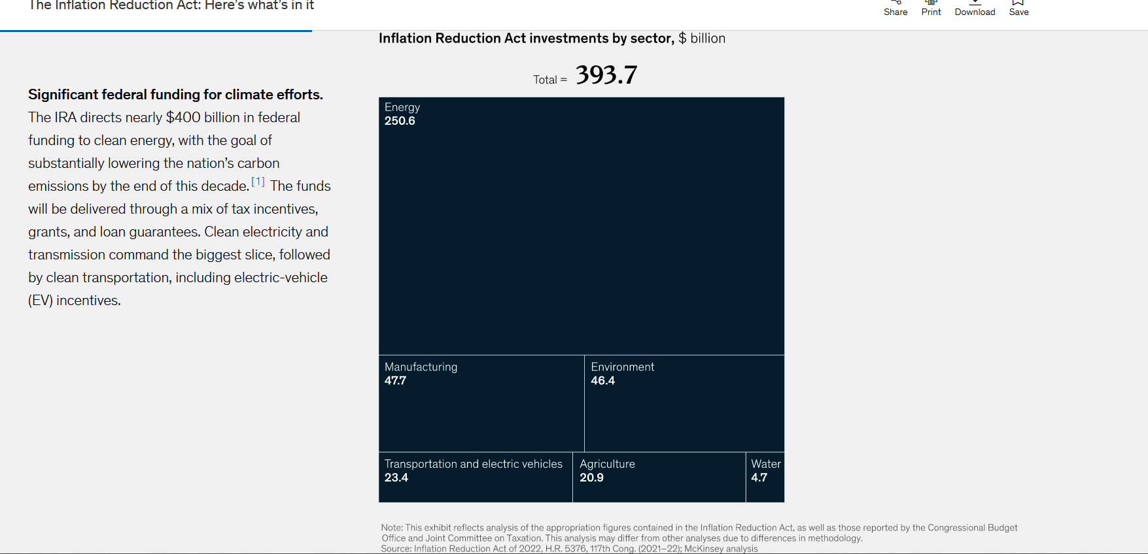
Industry Factors
Industry: Electric Utilities
1. Inflation reduction act (IRA)
The bill allocates 369$ billion towards us energy security and climate change initiatives
Duke
Executing an aggressive clean energy transition
Investing in electric grid enhancements and energy storage

Slide 12
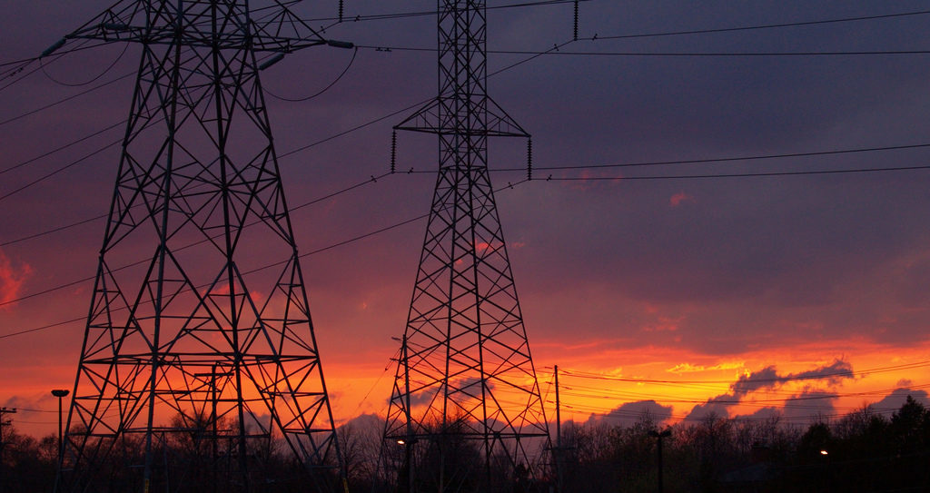
CATALYST
Industry: Electric Utilities
North Carolina Carbon Plan 70% carbon reduction by 2030
Plans to add regulated renewables at a record rate. 30,000 megawatts by 2035.
Modernizing the grid – In Indiana completed the TDSIC plan

Slide 13
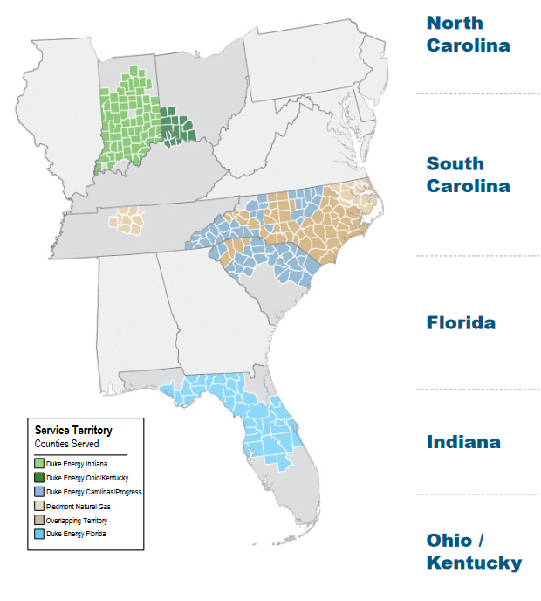
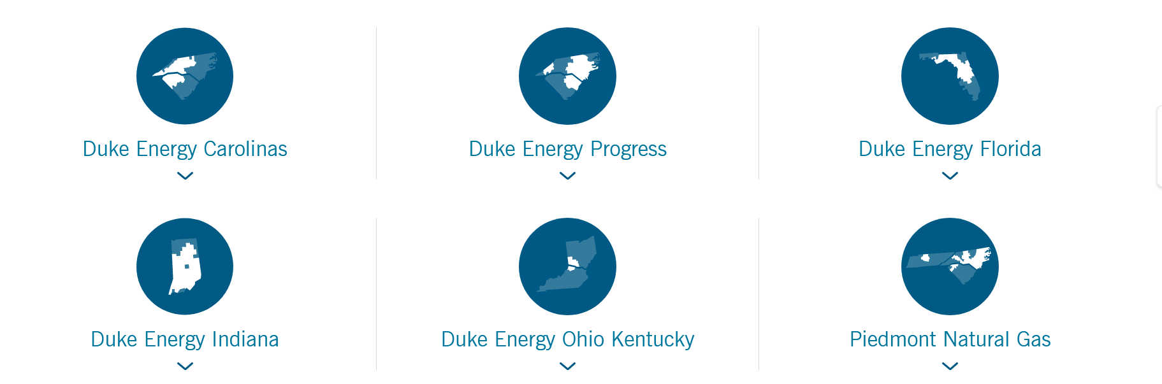
Industry: Electric Utilities
Duke Energy regulated utility - monopoly in the regions where it operates​
Growth will be modest. - reliable income, that's not a bad balance.
Defensive stock – will reduce the impact of other volatile stocks in the fund
The proceeds from two pending renewable deals - $1.4 billion - to strengthen balance sheet without issuing more equity
Investment Thesis
Source(s): S&P Net Advantage, Statista, U.S. Energy Information Administration

Slide 14
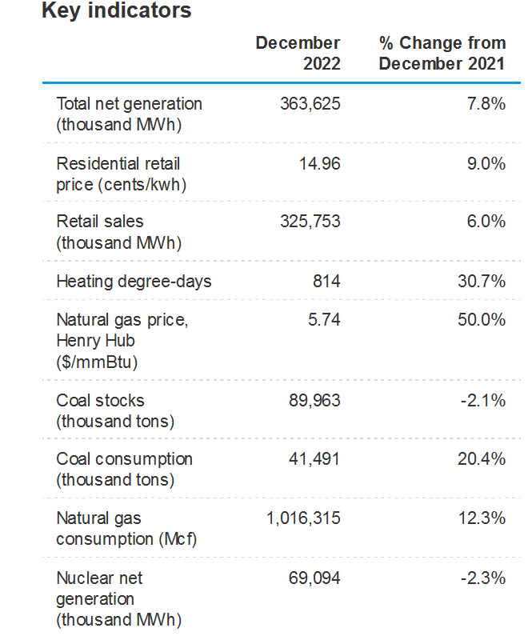
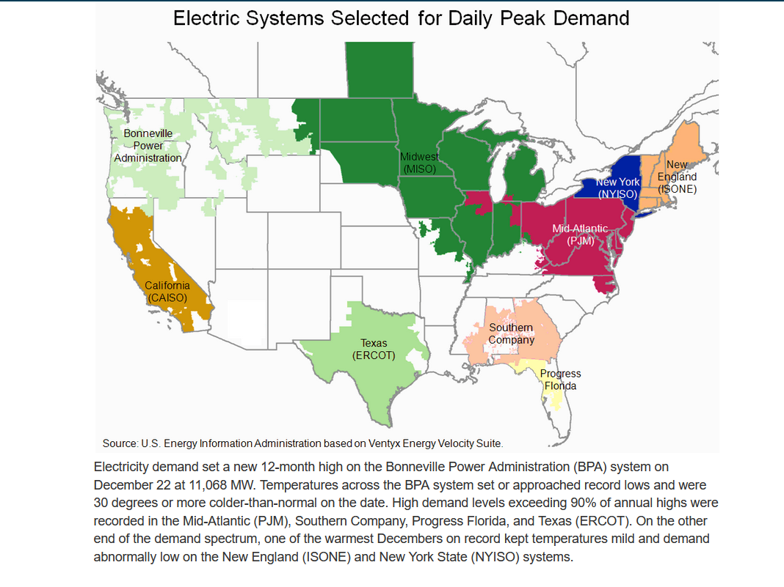
Industry: Electric Utilities
Investment Thesis
High demand levels exceeding 90% of annual highs were recorded not just the customers.. Energy consumption also increasing
Subsidiary of Duke Energy
https://www.eia.gov/electricity/monthly/update/archive/february2023/wholesale-markets.php

Slide 15
Risks
Industry: Electric Utilities
Competition – not just in utility but also increasing competition in the clean energy space
Regulators to approve the company's capital spending plan and its rate
https://www.eia.gov/electricity/monthly/update/archive/february2023/wholesale-markets.php

Slide 16
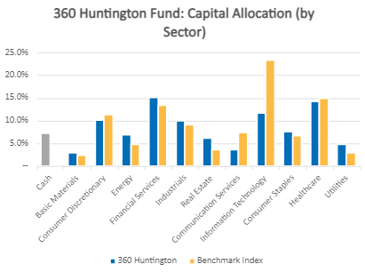
Portfolio Considerations

Slide 17
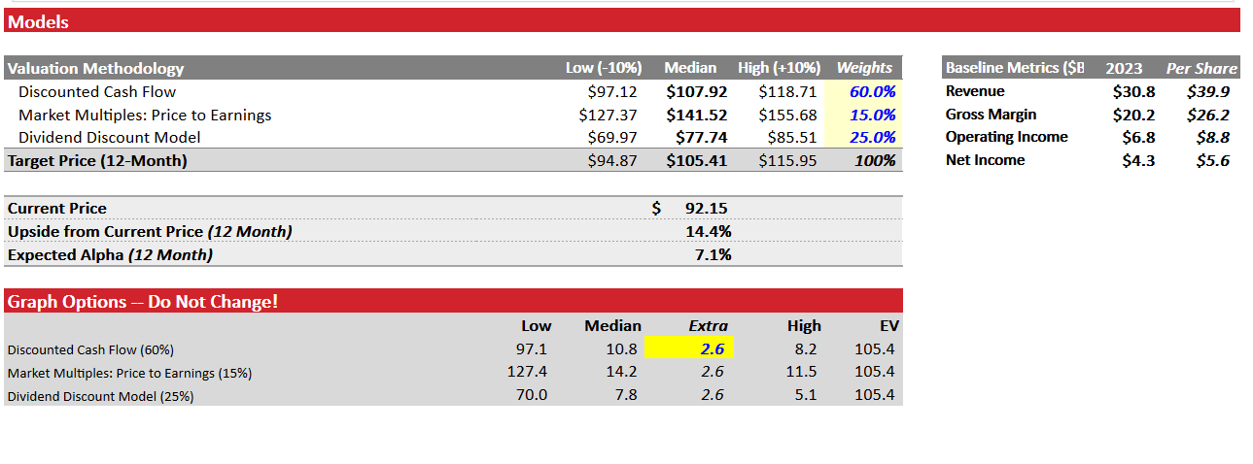
Valuation

Slide 18
Thank You

Slide 19
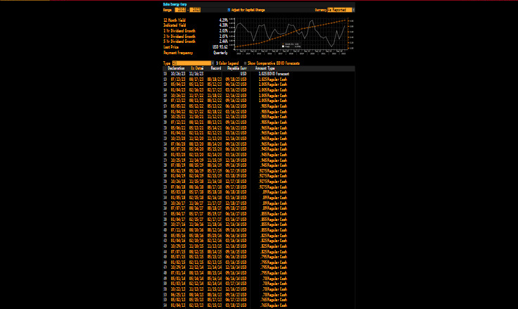
Dividends
2022 marked the 96th consecutive year the company paid quarterly cash dividends

Slide 21
Ratios
Ratio | Company | Industry
P/E | 17.4 | 10.55
Price to sales | 2.49 | 3.21
Price to book | 1.51 | 2.39
LT debt to equity | 146.19% | 157.37
Total debt to equity | 162.92% | 179.7

Slide 22
Customers
Segment (in millions) | 2019 | 2020 | 2021 | 2022
Electric total | 7,779,560.00 | 7,917,648.00 | 8,061,220.00 | 8,197,017.00
Gas Total | 1,619,194.00 | 1,649,895.00 | 1,642,190.00 | 1,661,868.00

